Slide 1
A Restorative Approach to Conflict: Repairing Harm and Preventing Future Harm Spokane Public Schools Office of Family and Community Engagement
Restore Relationships
Build Community
Repair Harm

Slide 2
Learning Objectives
Philosophy of Restorative Practices
Why SPS uses Restorative Practices as its primary approach to conflict and behavior
How RP fits within the MTSS framework and discipline policies
The Repairing Harm Process

Slide 3
What is Restorative Justice?
Restorative Justice brings people together to reconcile and build relationships when harm has been done. A major tenant of Restorative Justice is that harm affects everyone in the community- the “victim/s”, “whoever does the harm” and the larger community. Therefore decisions about how to repair the harm must be determined by the people affected, as they are the only people who truly know how to make things right.
Restorative Justice aims to build understanding, explore how the wrongdoing has impacted those involved, and to develop agreements that increase trust, safety and understanding so that things are better in the future.

Slide 4
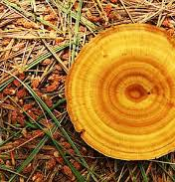
Indigenous Roots
Reflects ancient beliefs and practices of Indigenous peoples on many continents.
Building community based on shared values and shared humanity.
People in the community treat each other like relatives, where everyone belongs, and everyone matters.

Slide 5
Two Different Views of Misbehaviors -a paradigm shift-
Punitive View
Restorative View
What rule was broken?
Who did it?
System assigns consequence or punishment
What relationships were broken? Who was harmed?
Why did this happen? Whose needs were not met?
The impacted parties control how harm is repaired and needs are met

Slide 6
Restorative Discipline Shifts
Telling | Listening
Knowing the Answers | Being Curious
Institution / Third Party Trying to Restore Balance | Those affected trying to restore balance
Focus on Wrongdoer | Focus on those harmed and those who caused harm
External Coercion | Internal Motivation

Slide 7
Conflicts are a part of daily life and making mistakes is a part of growing and learning. With this in mind, SPS embraces a restorative approach to conflict, meaning that we see conflicts and harmful behavior as an opportunity for students and staff to:
Learn about themselves and each other
Take accountability
Develop empathy
Repair harm and restore relationships
Identify supports that meet the individual for each of our students.
Excerpt from
SPS webpage on
Restorative Practices

Slide 8
Tier 3 – Repairing Harm
Formal Conferences
Tier 2 – Responding to Conflict
Mediation * Rupture Repair Dialogues
Tier 1 – Building Community/Preventing Conflict
Affective Statements * Restorative Questions * Proactive Circles
MTSS
Framework

Slide 9
Restorative Practice Assumptions
The world is profoundly interconnected
All human beings have a deep desire to be in good relationship
All human beings have inherent dignity
All human beings have gifts and everyone is needed for what they bring
The people most affected by a conflict should drive the process for repair
Harmful behavior often comes from unmet needs; A response that pushes away generally increases harm and a response that pulls in closer helps reduce future harm.
People will make positive changes when those in authority do things with them, rather than to or for them.
Derived from and build on indigenous teachings and other wisdom traditions. Excerpted from Heart of Hope and Circle Forward by Carolyn Boyes-Watson and Kay Pranis, as well as Boston Public Schools.

Slide 10
The child who is not embraced by the village will burn it down to feel its warmth -African Proverb

Slide 11
Think of a time when you were harmed….
What did you feel? What did you need to make things right?
Think of a time when you caused harm…..
What did you feel? What did you need to make things right?

Slide 12
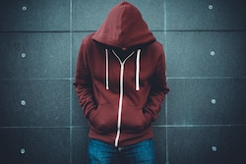
Harm in our Schools

Slide 13
Restorative Strategies will not be Effective and a Restorative Environment will not be Created unless: 1) Strong Relationships Exist and 2) Participants are Calm (thinking brain v. survival brain)
If we want young people to be accountable for their actions and to repair damage to relationships in the event of a conflict, then we need to develop relationships in the first place. There needs to be something there to repair.
Belinda Hopkins (Dir. Transforming Conflict)

Slide 14
Step 1: Conversation with the person who caused harm
Mindset: Calm, Curious, Non-Judgmental, Willing to Listen, Open-Minded, Aware of Biases and Triggers
Questions to Guide the Conversation:
What happened?
What were you thinking/feeling at the time?
Why did this happen?
Who was impacted?
What needs to be done to make things right? What are you willing to do?
How can you/we prevent this from happening again?

Slide 15
Step 2: Who was impacted?
Other students
You! Administrators, teachers, office staff, custodial staff
Entire classes
Community members or parents
Their own caregivers
Siblings or relatives in the school

Slide 16
Step 3: Conversations with people who were impacted
Mindset: Calm, Curious, Listen, Open-Minded
Conditions: Safe, Private, Ample Time, Trusted Adult Facilitating, Support Person Available
Questions to Guide the Conversation:
What happened?
How did this impact you?
What information do you need?
What do you want the person who caused harm to know?
What needs to happen to make this as right as possible?
What do you need to feel safe?
What questions do you have?

Slide 17
Step 4: Menu of Restorative Interventions
Guidepost: The impacted people must determine which process guides the repair.
Timing: In lieu of exclusionary discipline, during exclusionary period, or upon re-entry
Types of Restorative Interventions
Facilitated Restorative Conference – sharing of perspectives, impact, needs; may or may not result in agreement.
Apology letters, Restitution Agreements, Community Service, Agreements to address root causes (treatment, counseling, etc) – often are the result of a formal conference.

Slide 18
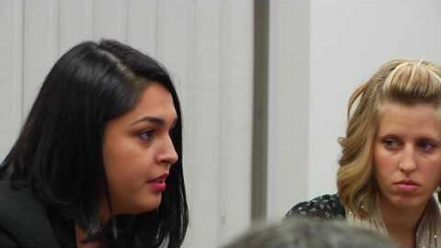

Slide 19
Goals of the Repair Process
For the person who caused harm:
Understand the impact of their behavior (empathy)
Take accountability for their role (self-reflection)
Repair the harm (active role in the repair)
Reintegration into the community with supports to address root causes of behavior (prevent recurrence of the behavior)
For the person who was harmed:
Share their story and the impact it had on them (empowerment)
Ask questions and get answers (need for information)
Express their needs for healing and have those needs met (restitution)
For the community:
Sense of safety, access to information, support role

Slide 20
Elements of the Repair Process
Participant driven
Voluntary
Inclusive
Primarily dialogical

Slide 21
Resources
Spokane Public Schools Website
Little Books of……
Juliesc@spokaneschools.org
Coordinators – how this fits with discipline

